Slide 1
Topics
Time Walk Correction From the Beginning
Measurements Inside an Event Loop
Gaussian Mixtures for PNR Analysis
Notes:
Time Walk Correciton Because people might not know when it is useful and when it isn’t

Slide 2
Topics
Time Walk Correction
Who is walking and why is time the one doin it??
Notes:
Time Walk Correciton Because people might not know when it is useful and when it isn’t

Slide 3
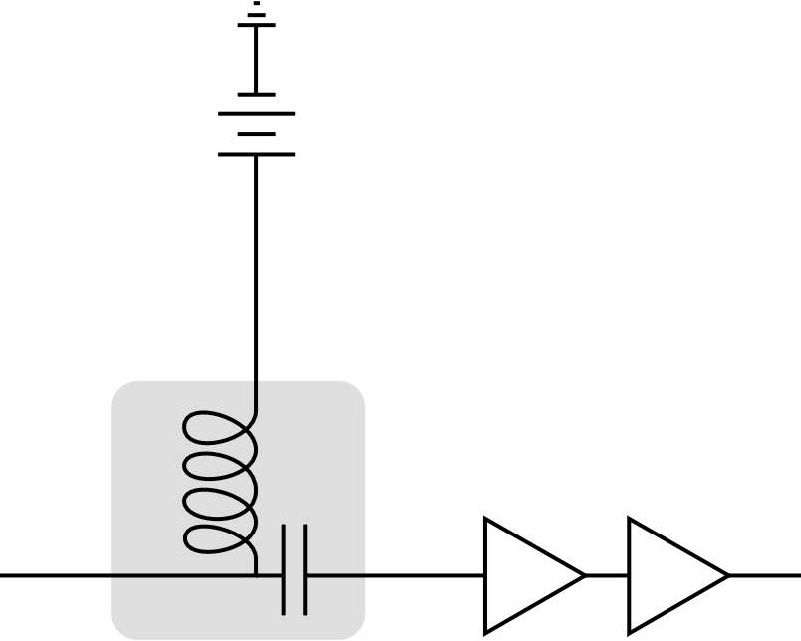
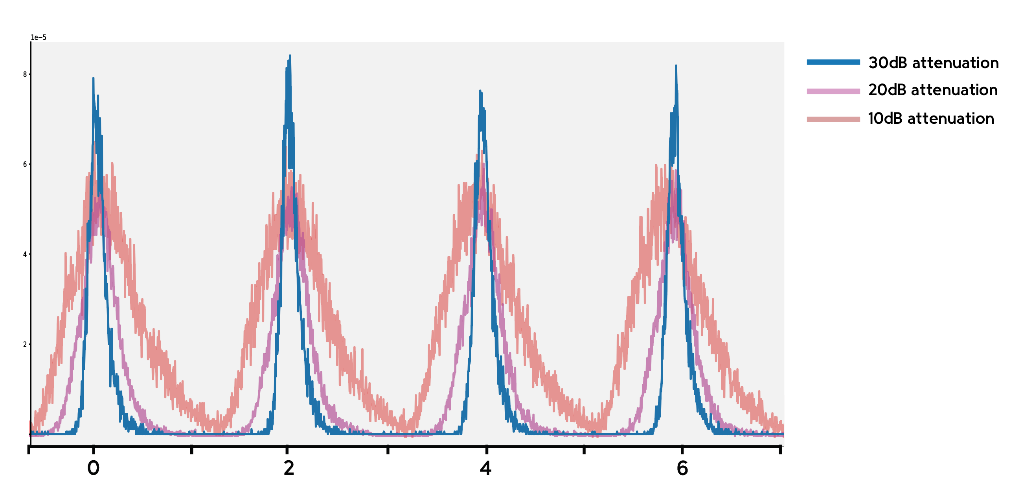
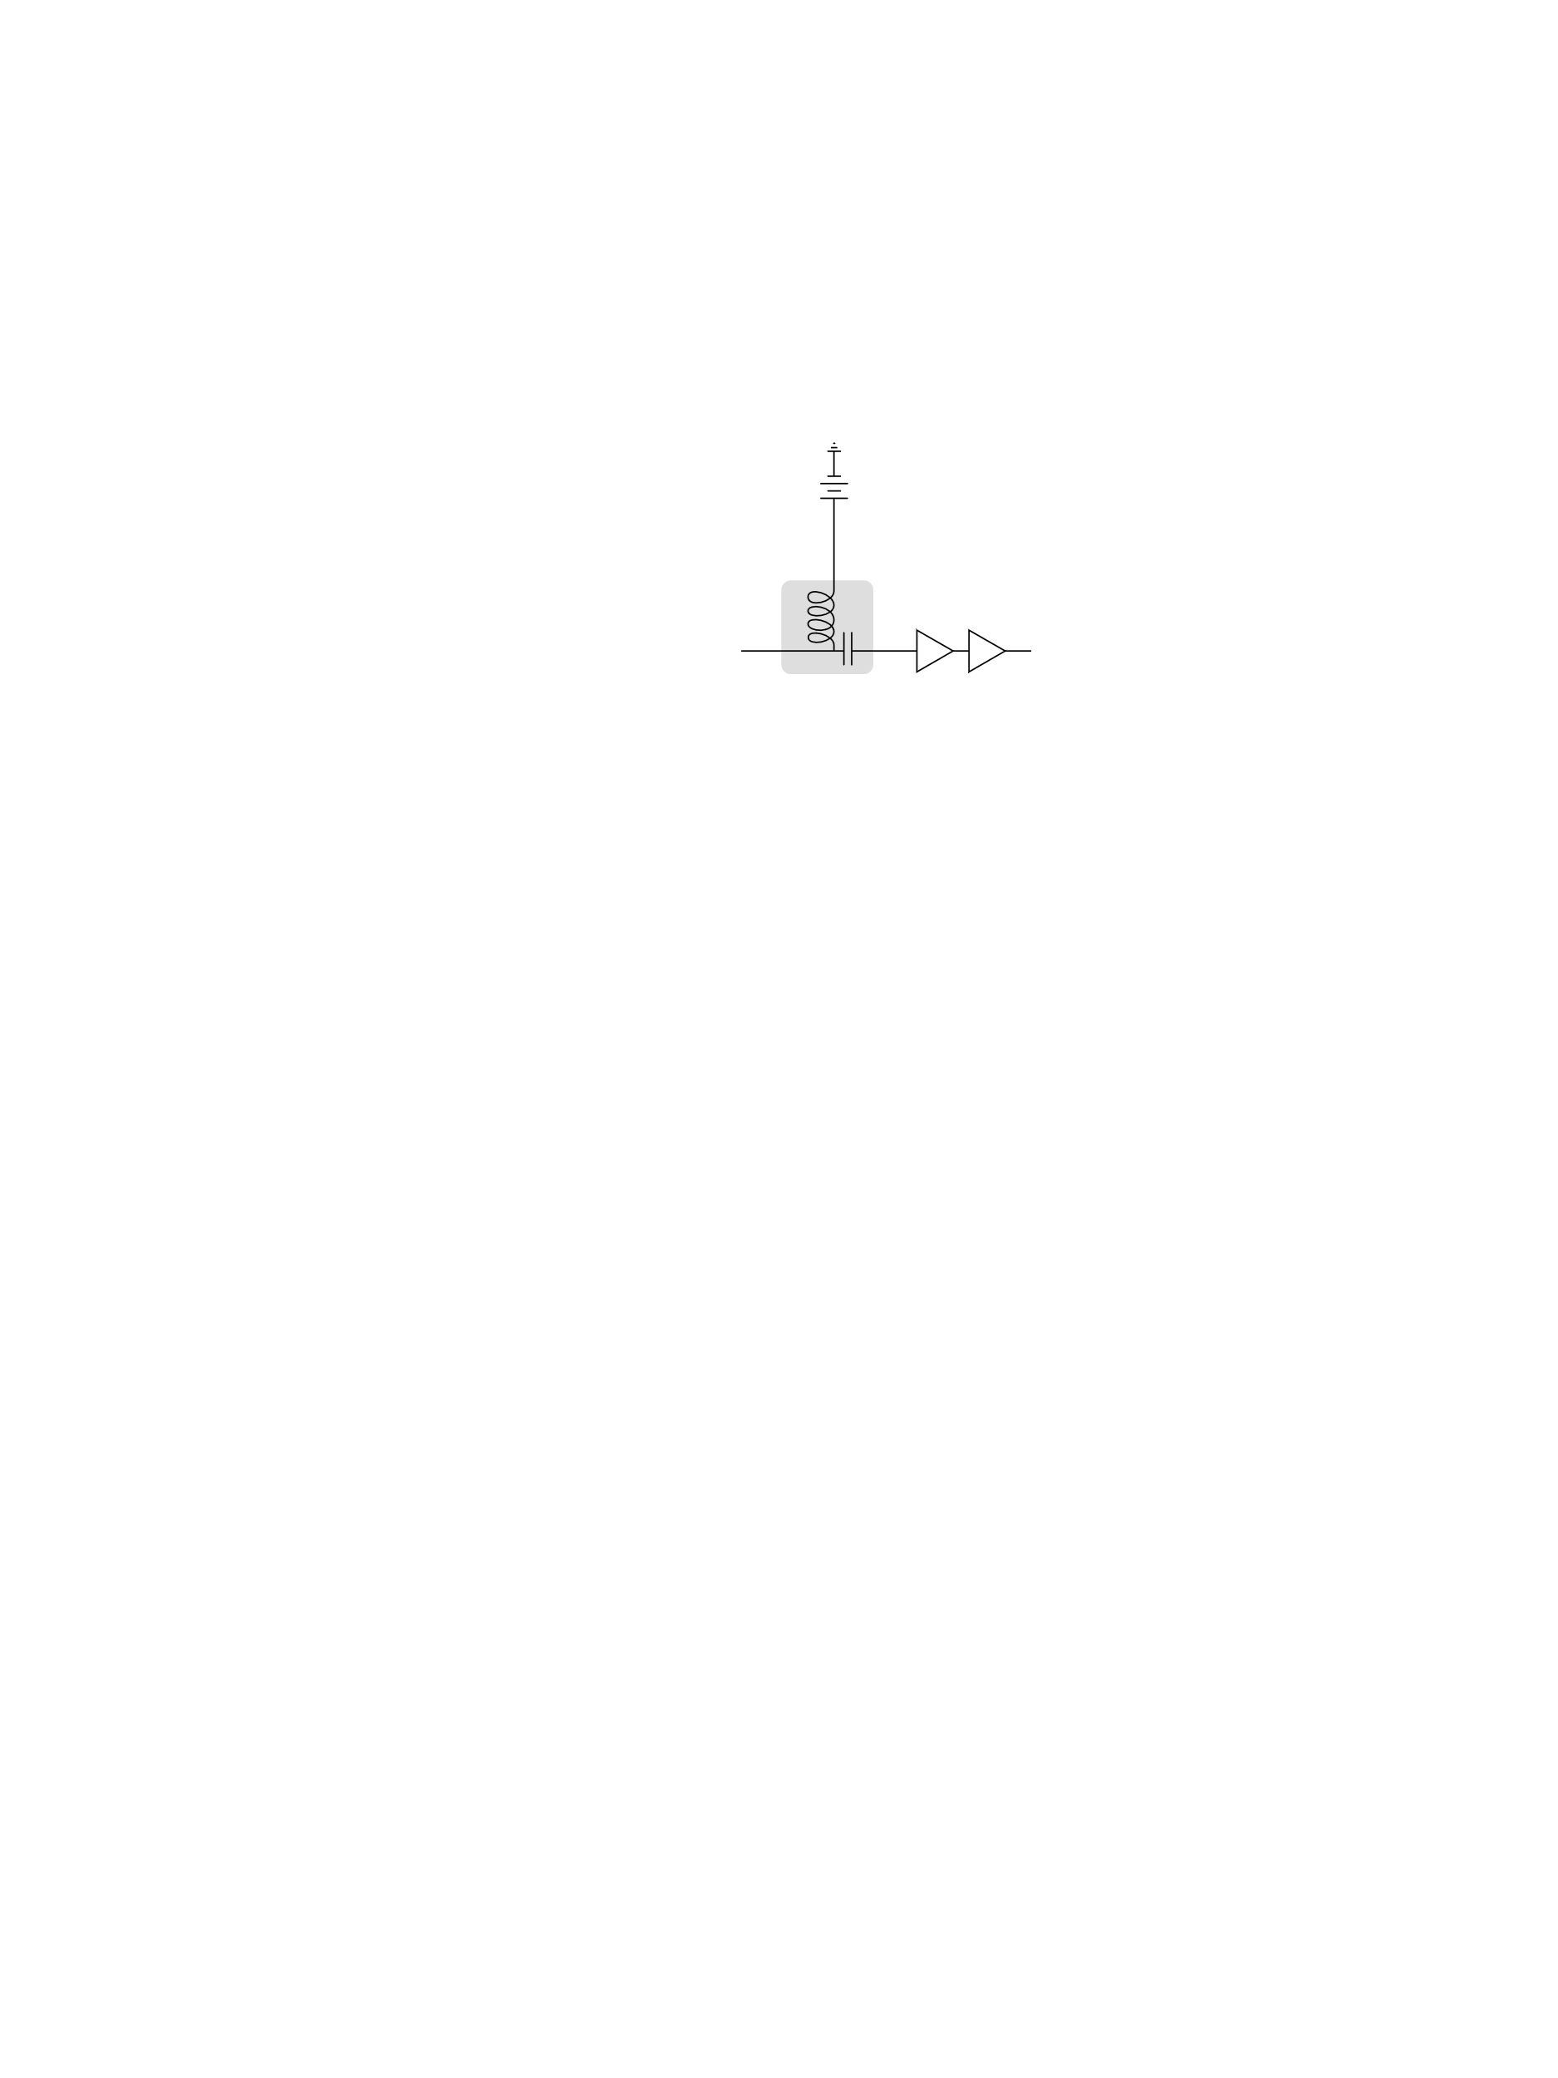
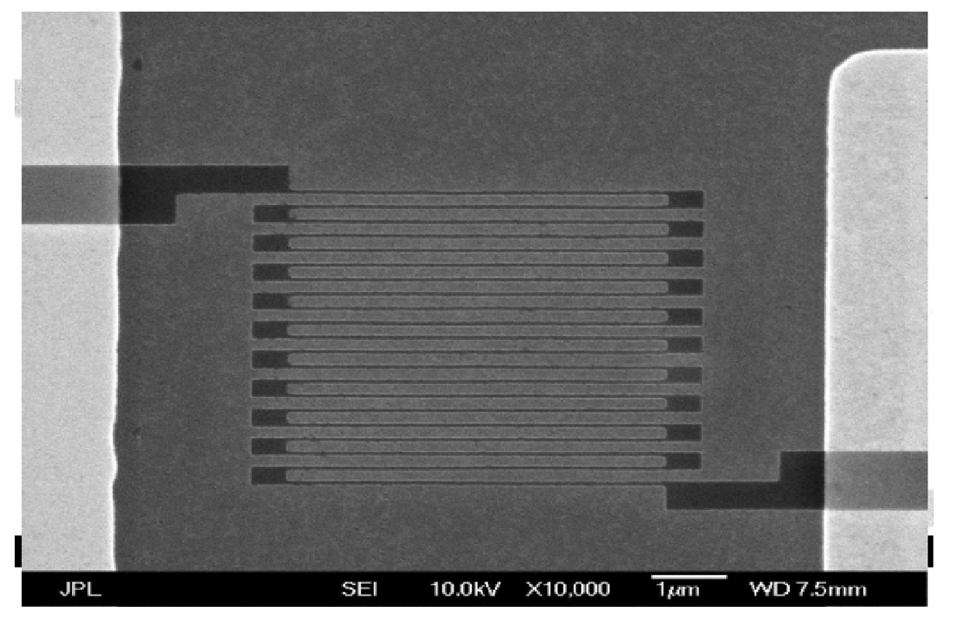
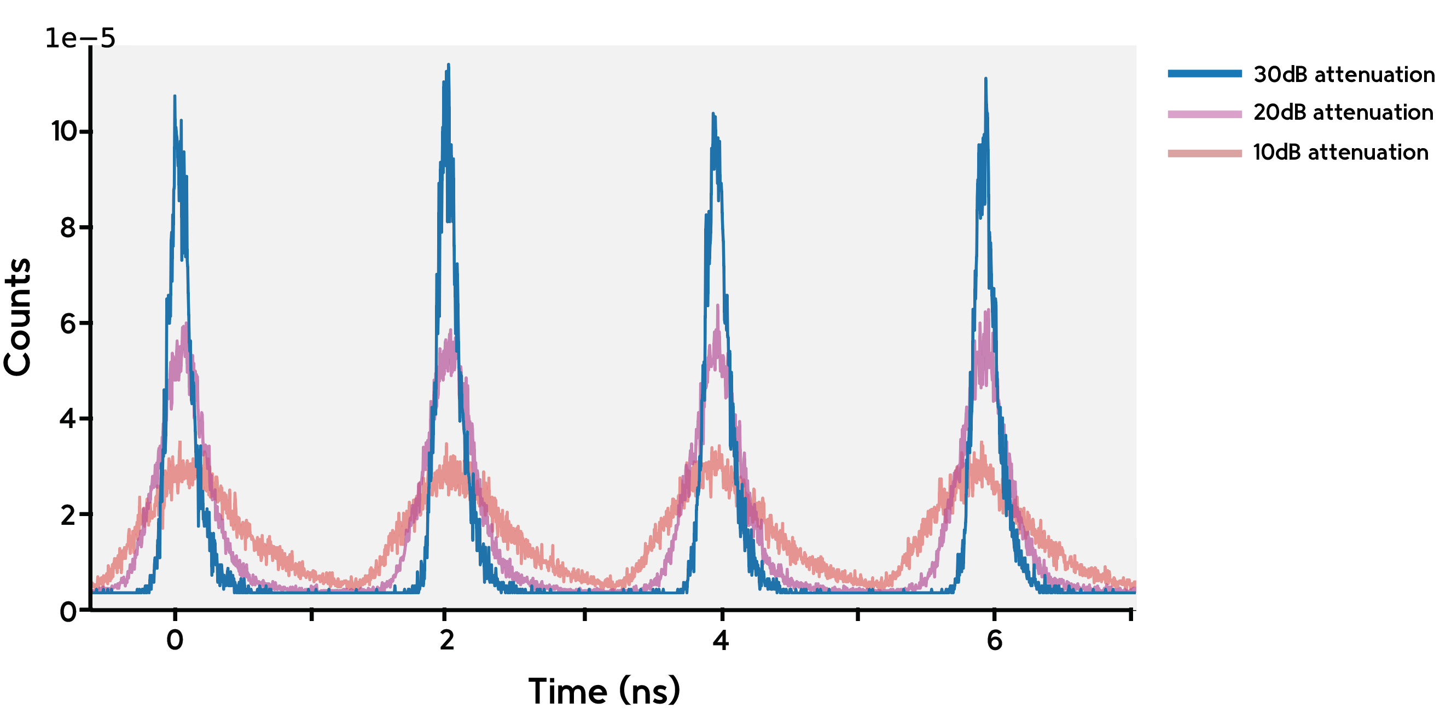
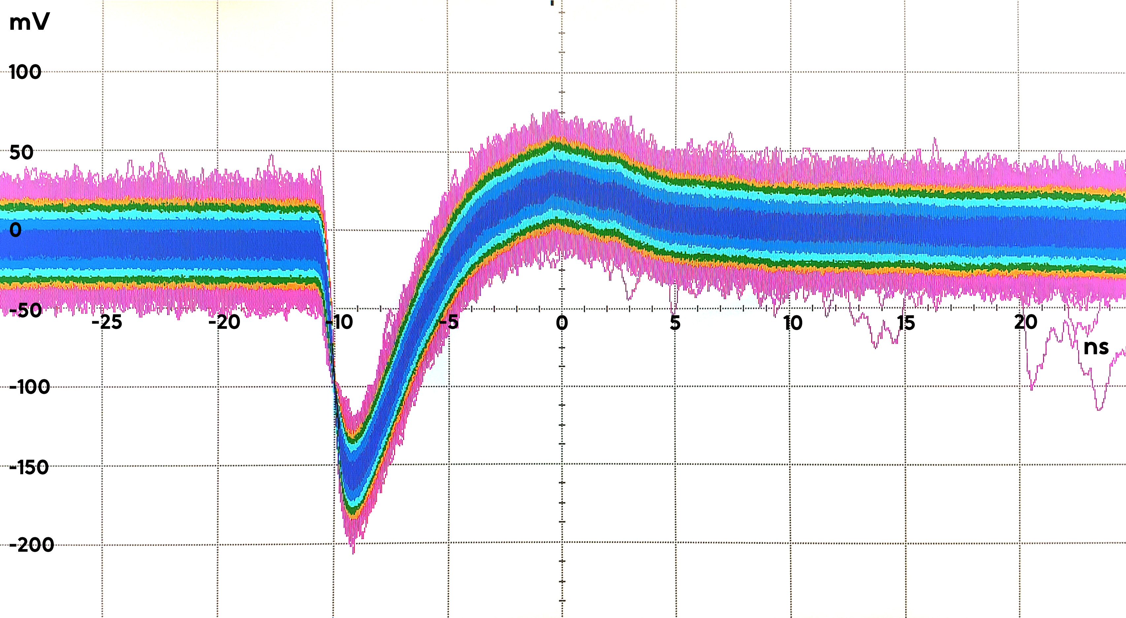
Time Walk Correction 1
bias
biasT
readout
Notes:
Notes for slide 1

Slide 4
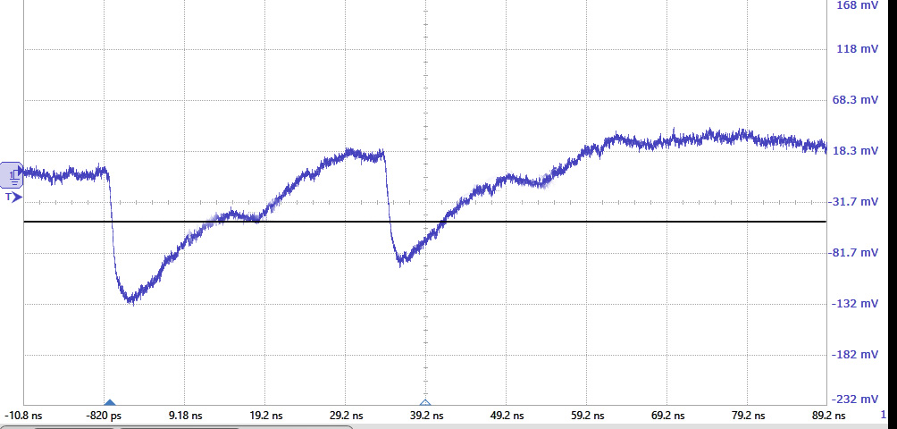
Time Walk Correction 1
Notes:
Notes for slide 1

Slide 5
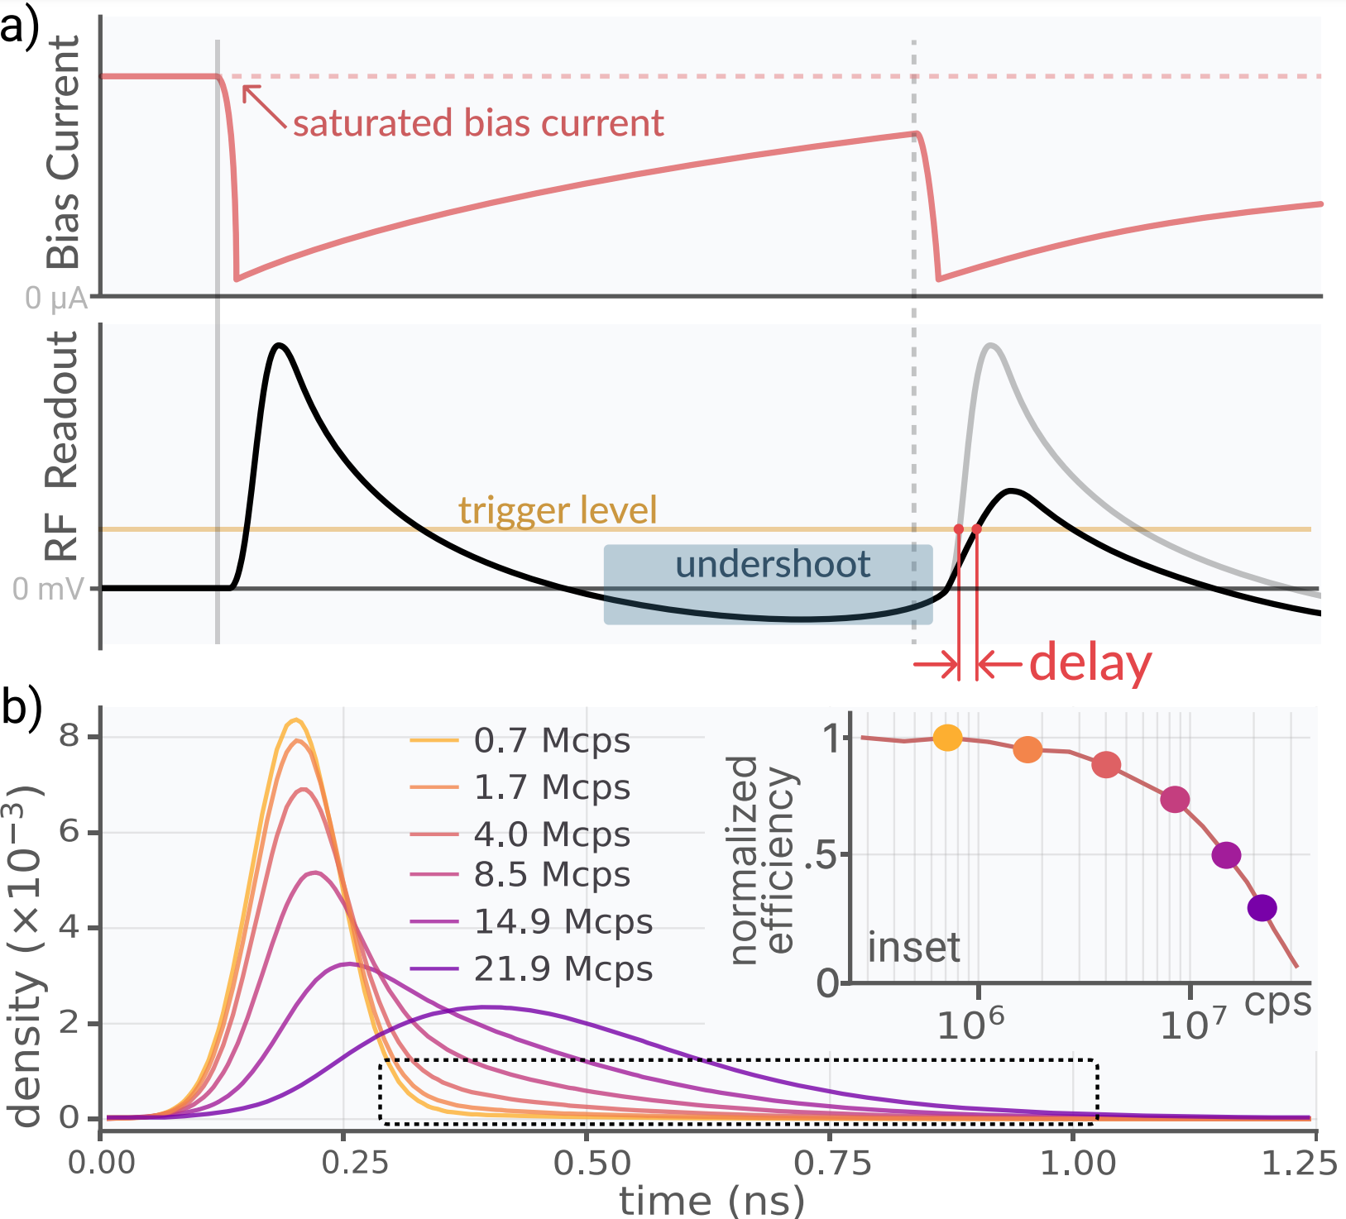
Time Walk Correction 2
Notes:
Notes for slide 1

Slide 6
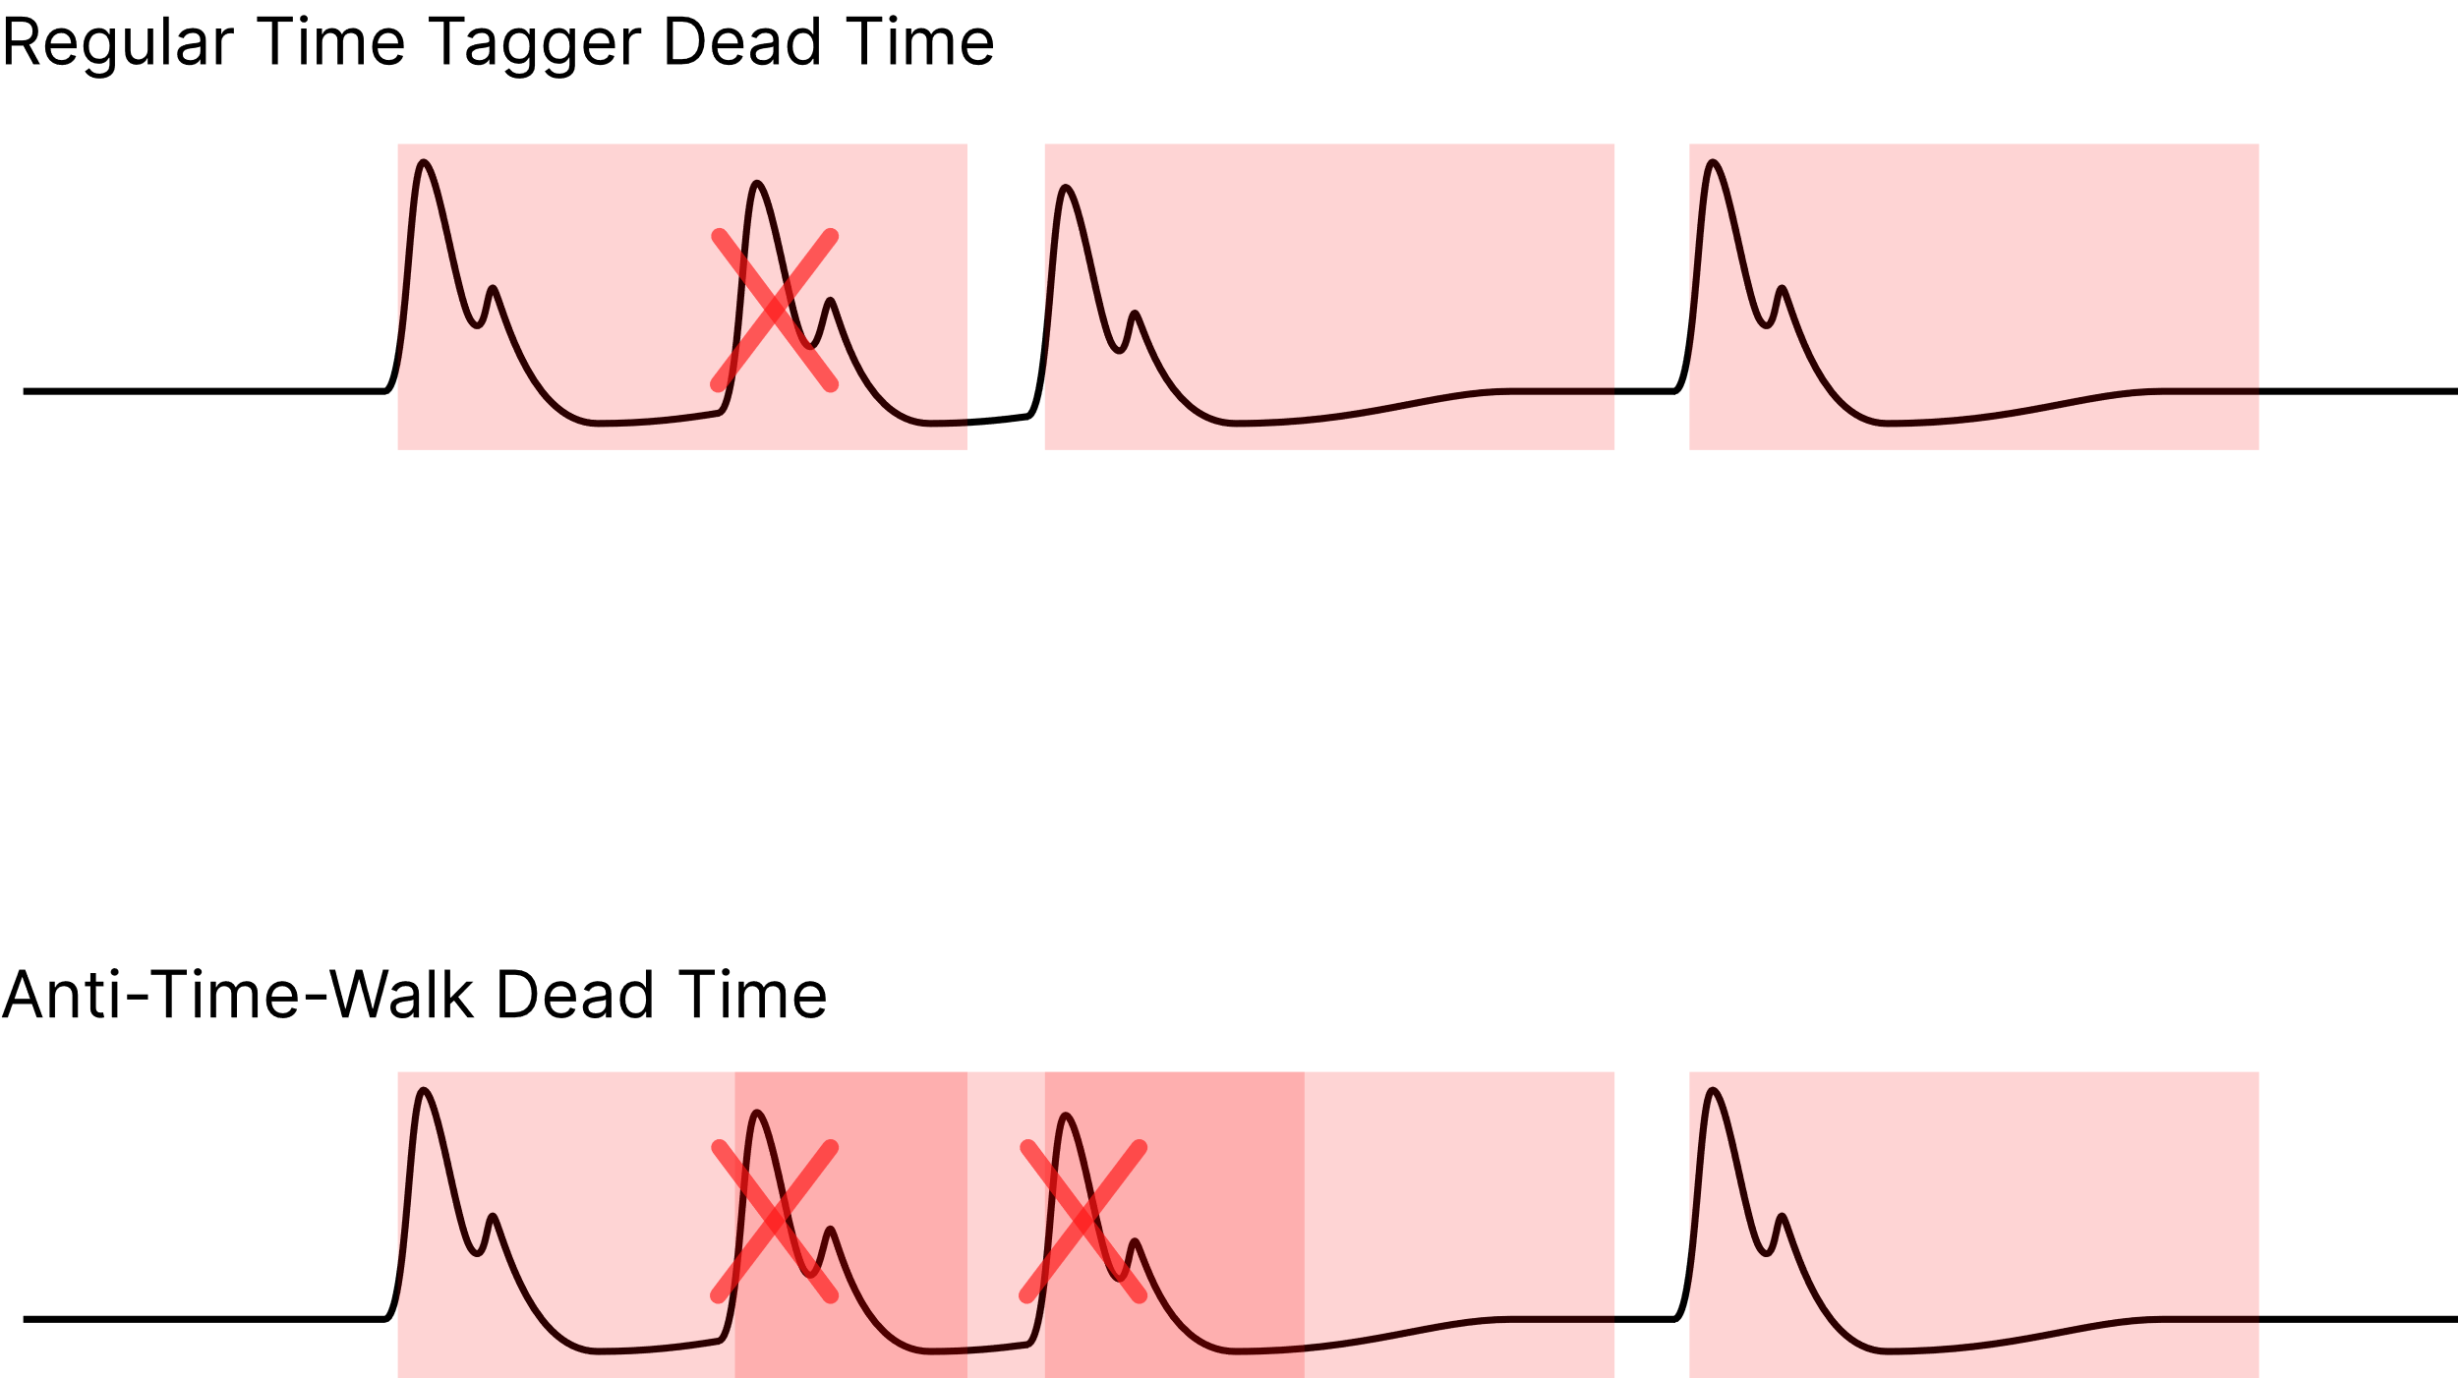
Time Walk Correction 3
What if we filtered out corrupted pulses?
Notes:
Notes for slide 1

Slide 7
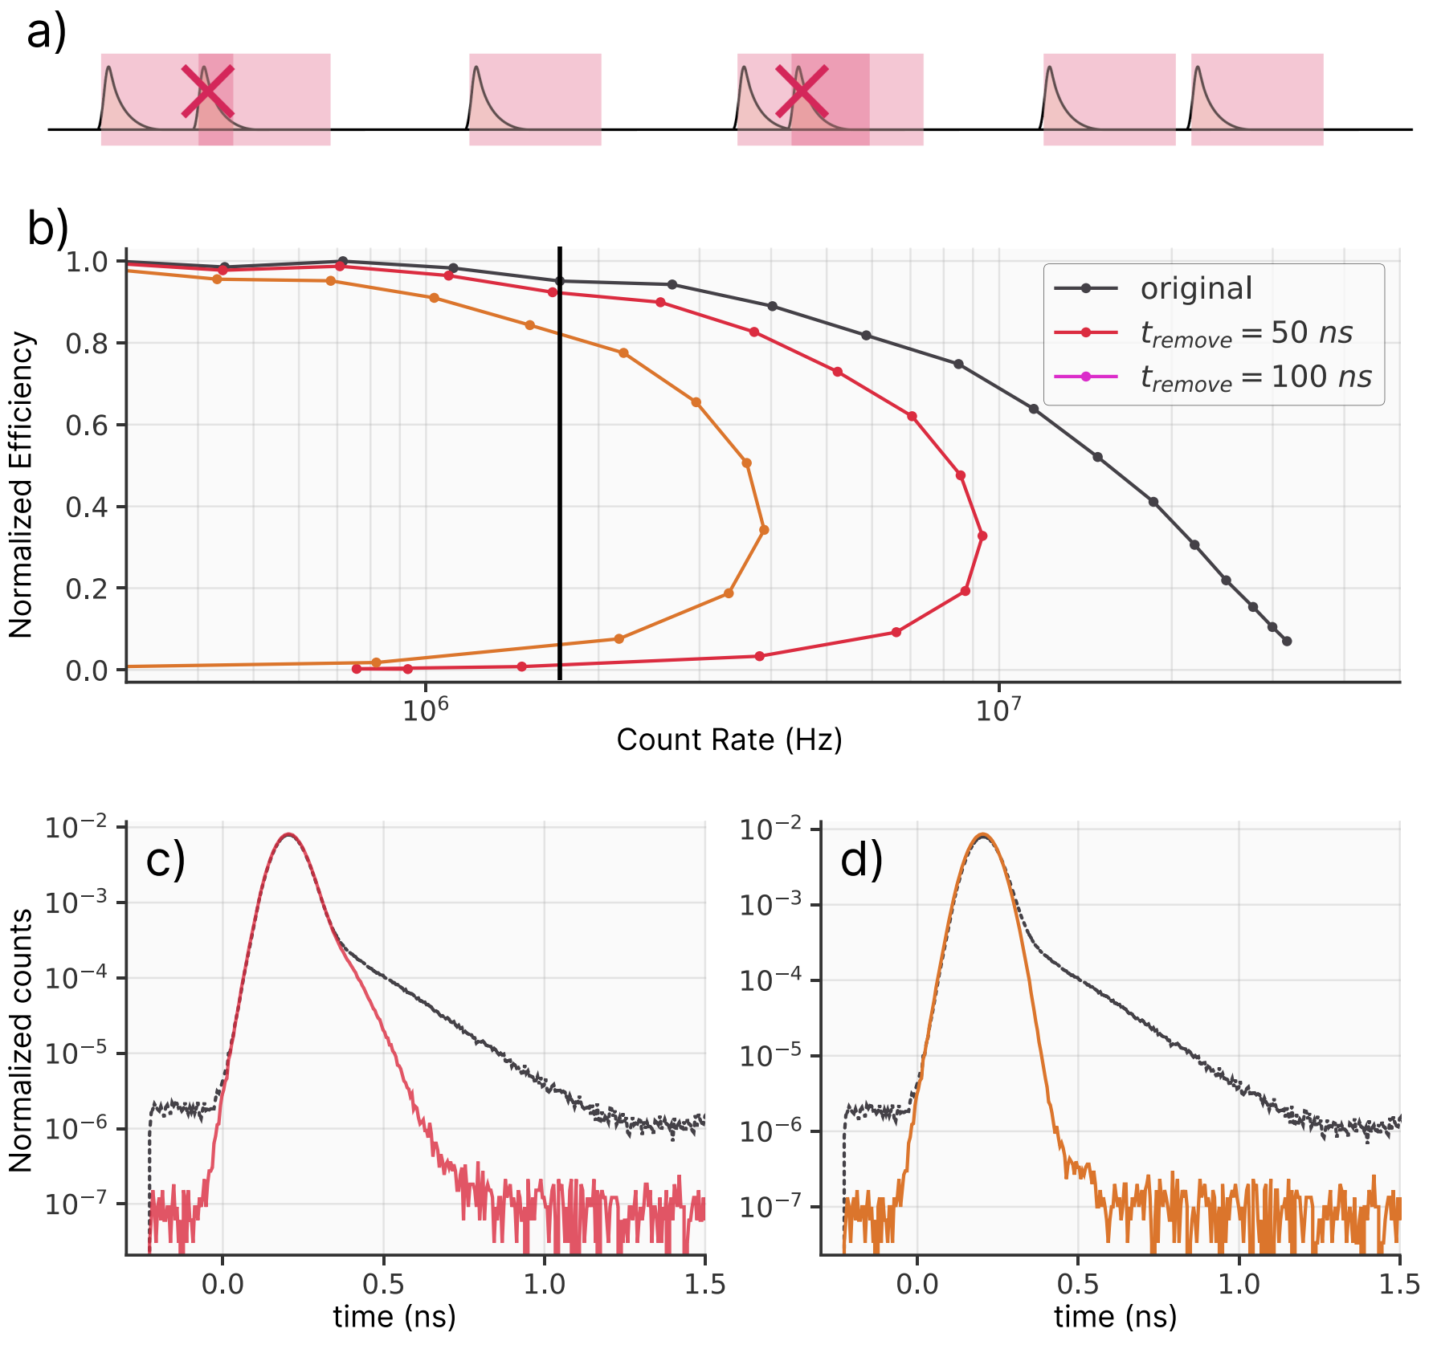
Time Walk Correction 3
What if we filtered out corrupted pulses?
Notes:
Notes for slide 1

Slide 8
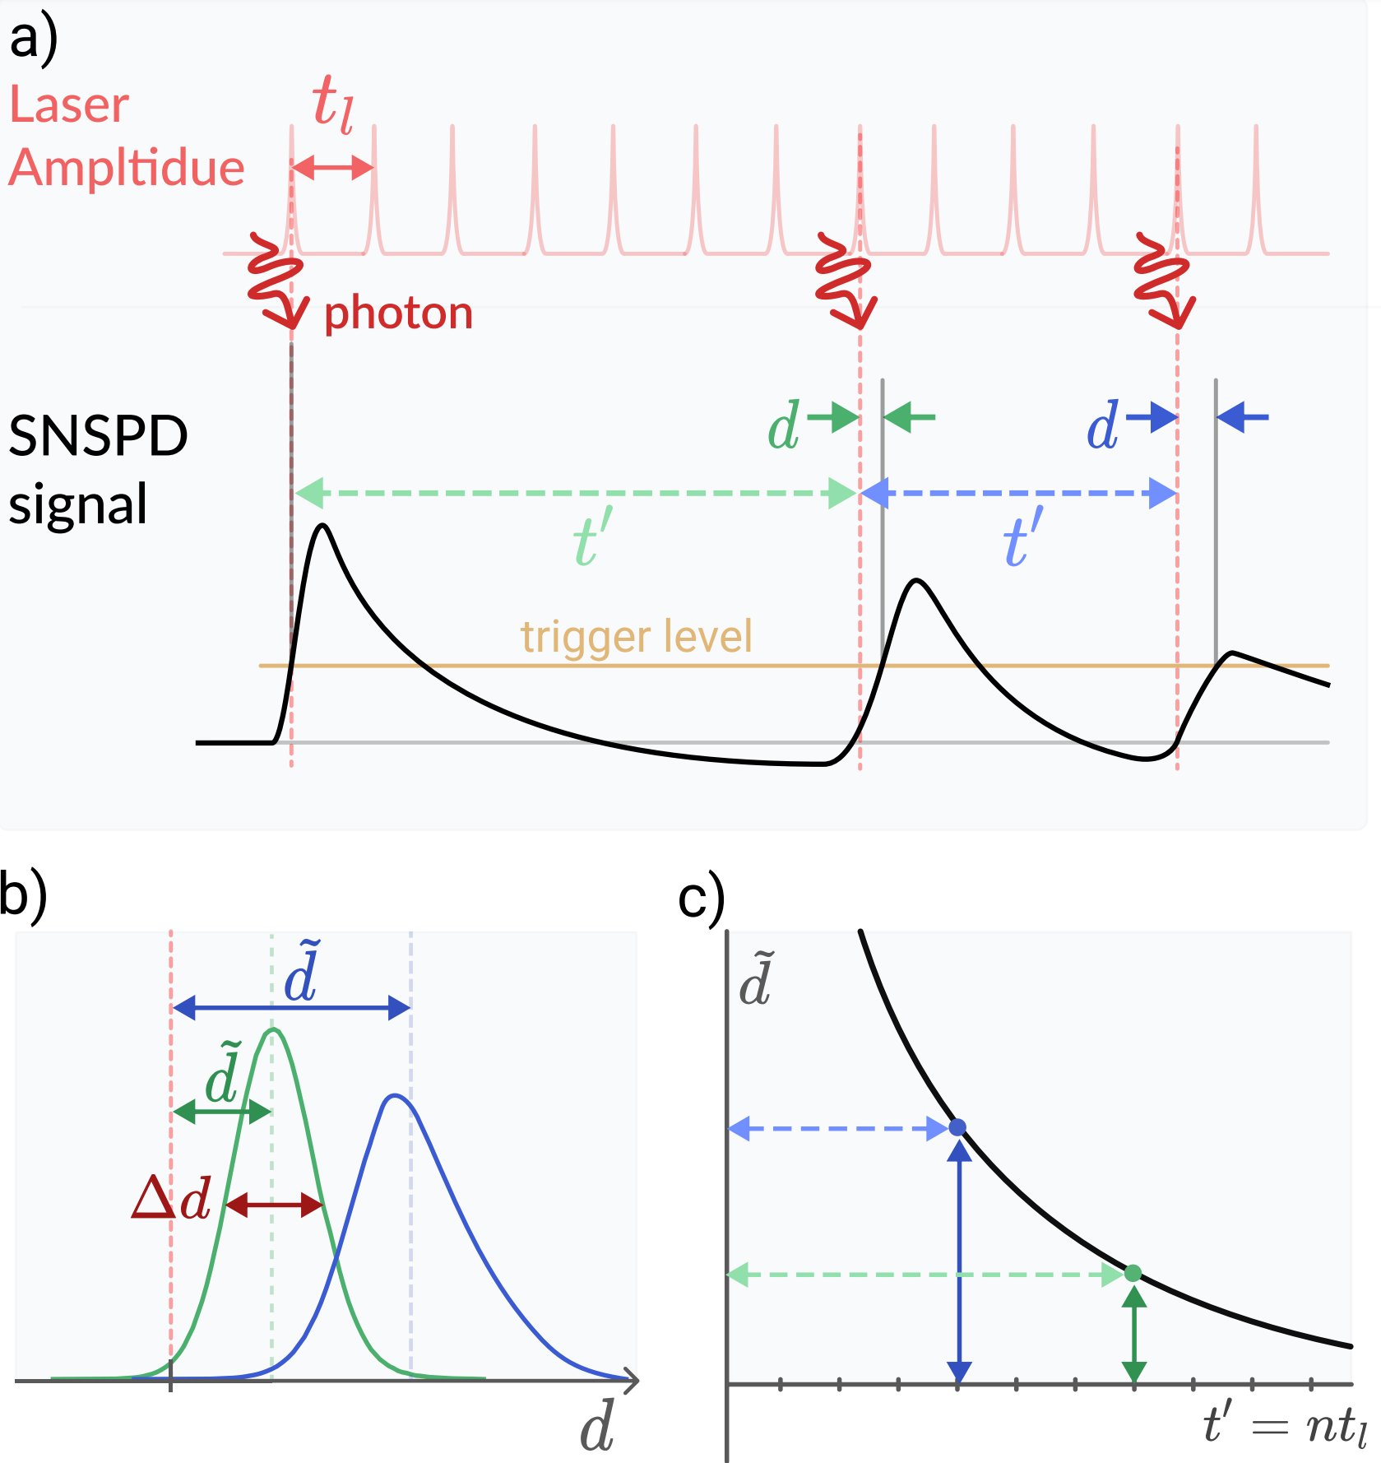
Time Walk Correction 4
Notes:
Notes for slide 1

Slide 9
Time Walk Correction 4
Notes:
Notes for slide 1

Slide 10
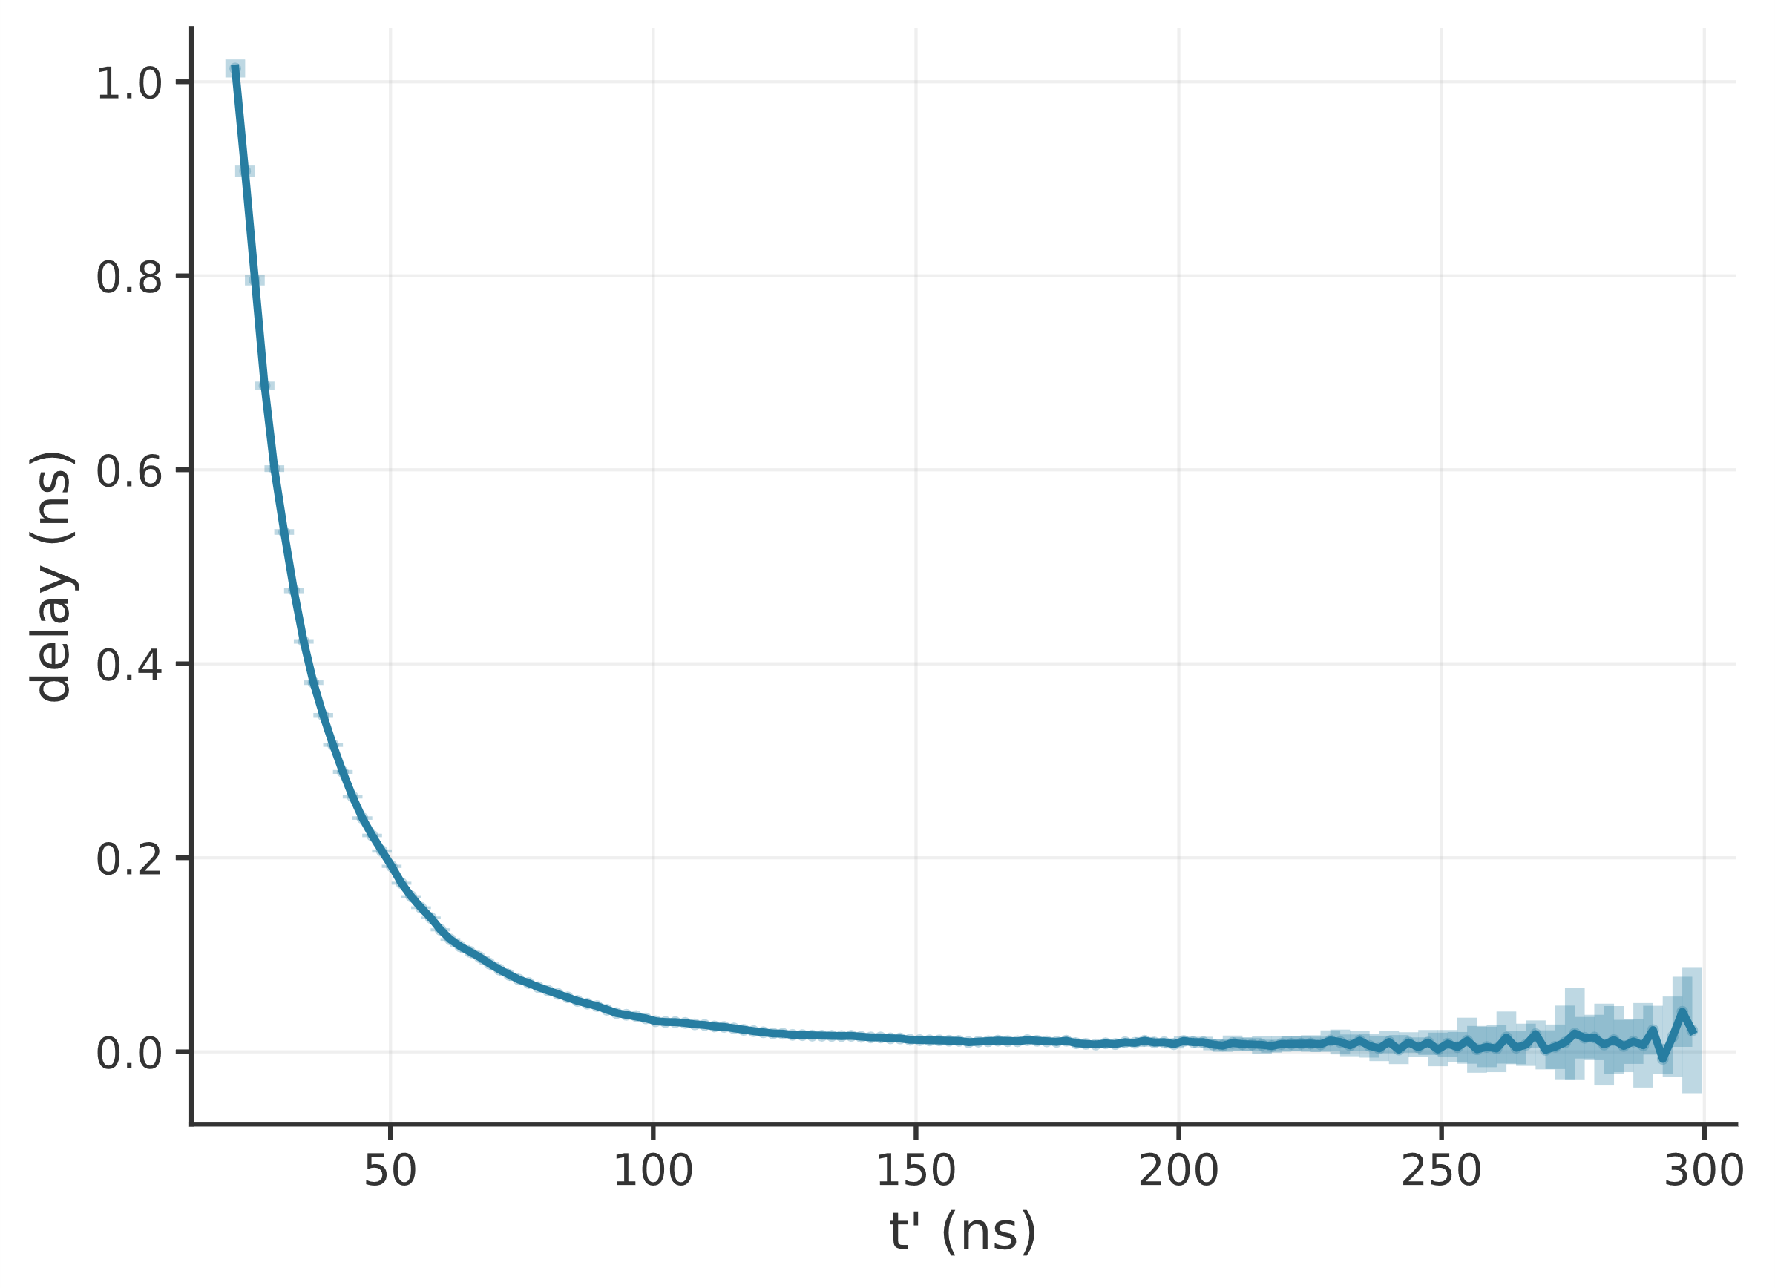
Time Walk Correction 5
Notes:
Notes for slide 1

Slide 11
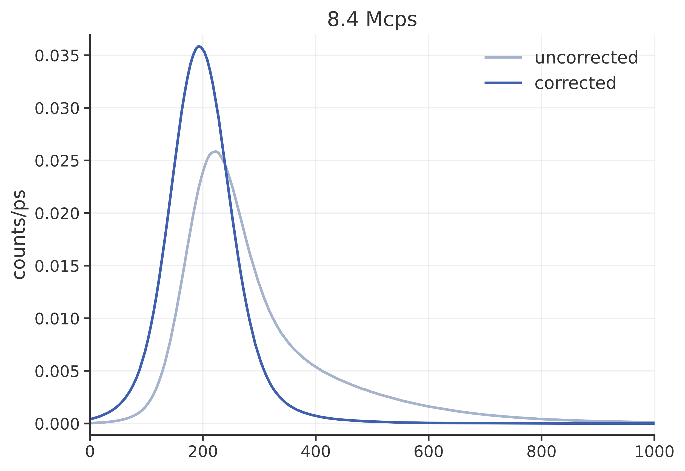
Time Walk Correction 5
Notes:
Notes for slide 1

Slide 12
Time Walk Correction 6
Notes:
Notes for slide 1

Slide 13
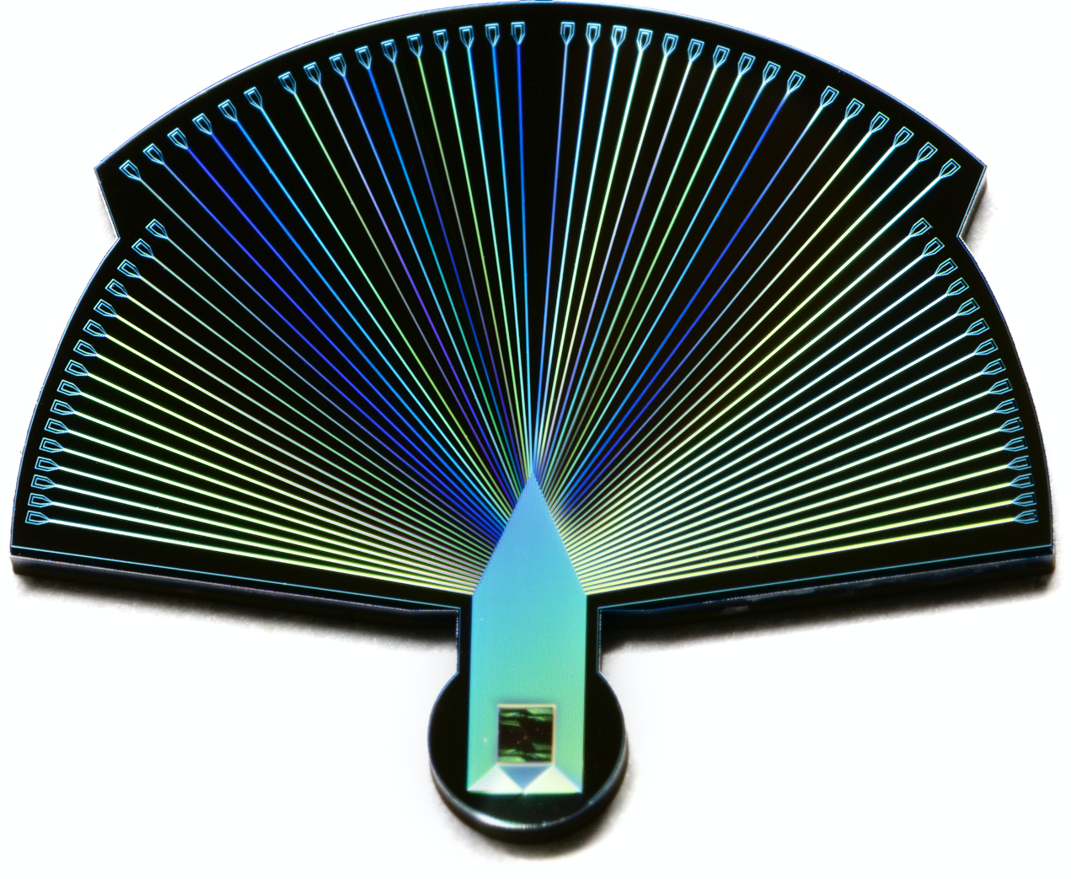
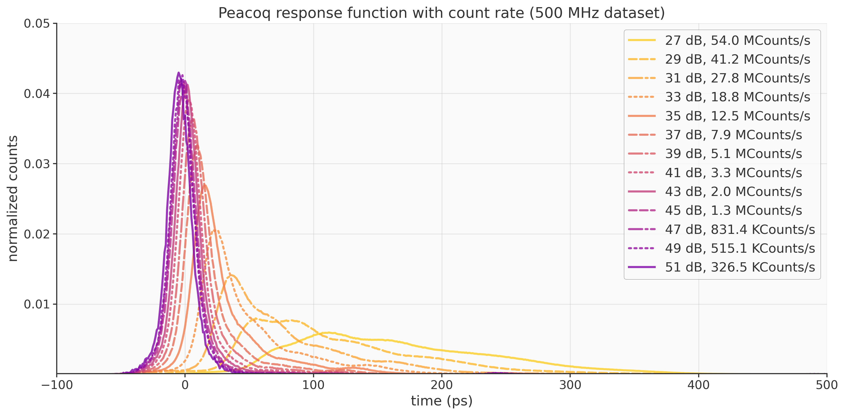
Time Walk Correction 7
Notes:
Notes for slide 1

Slide 14
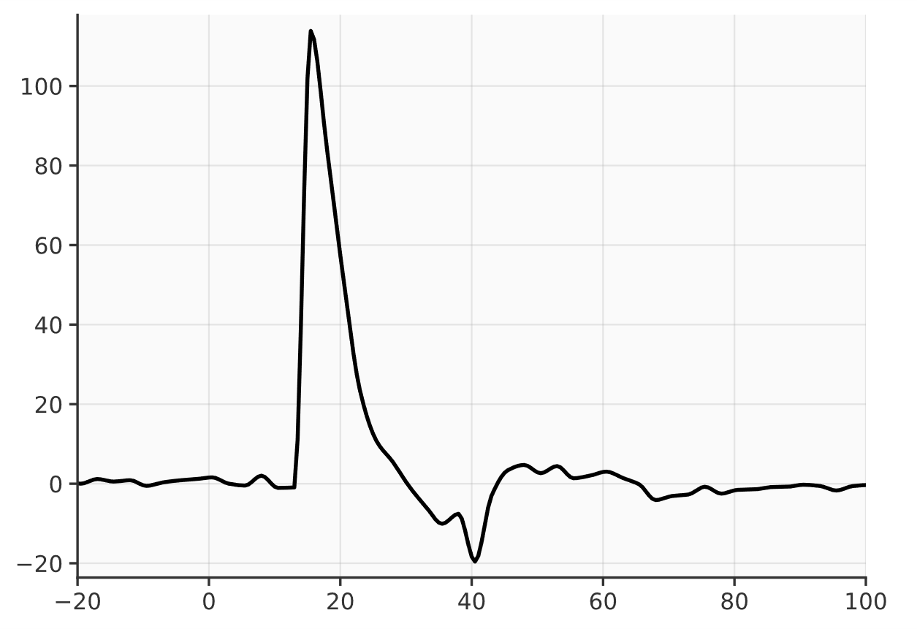
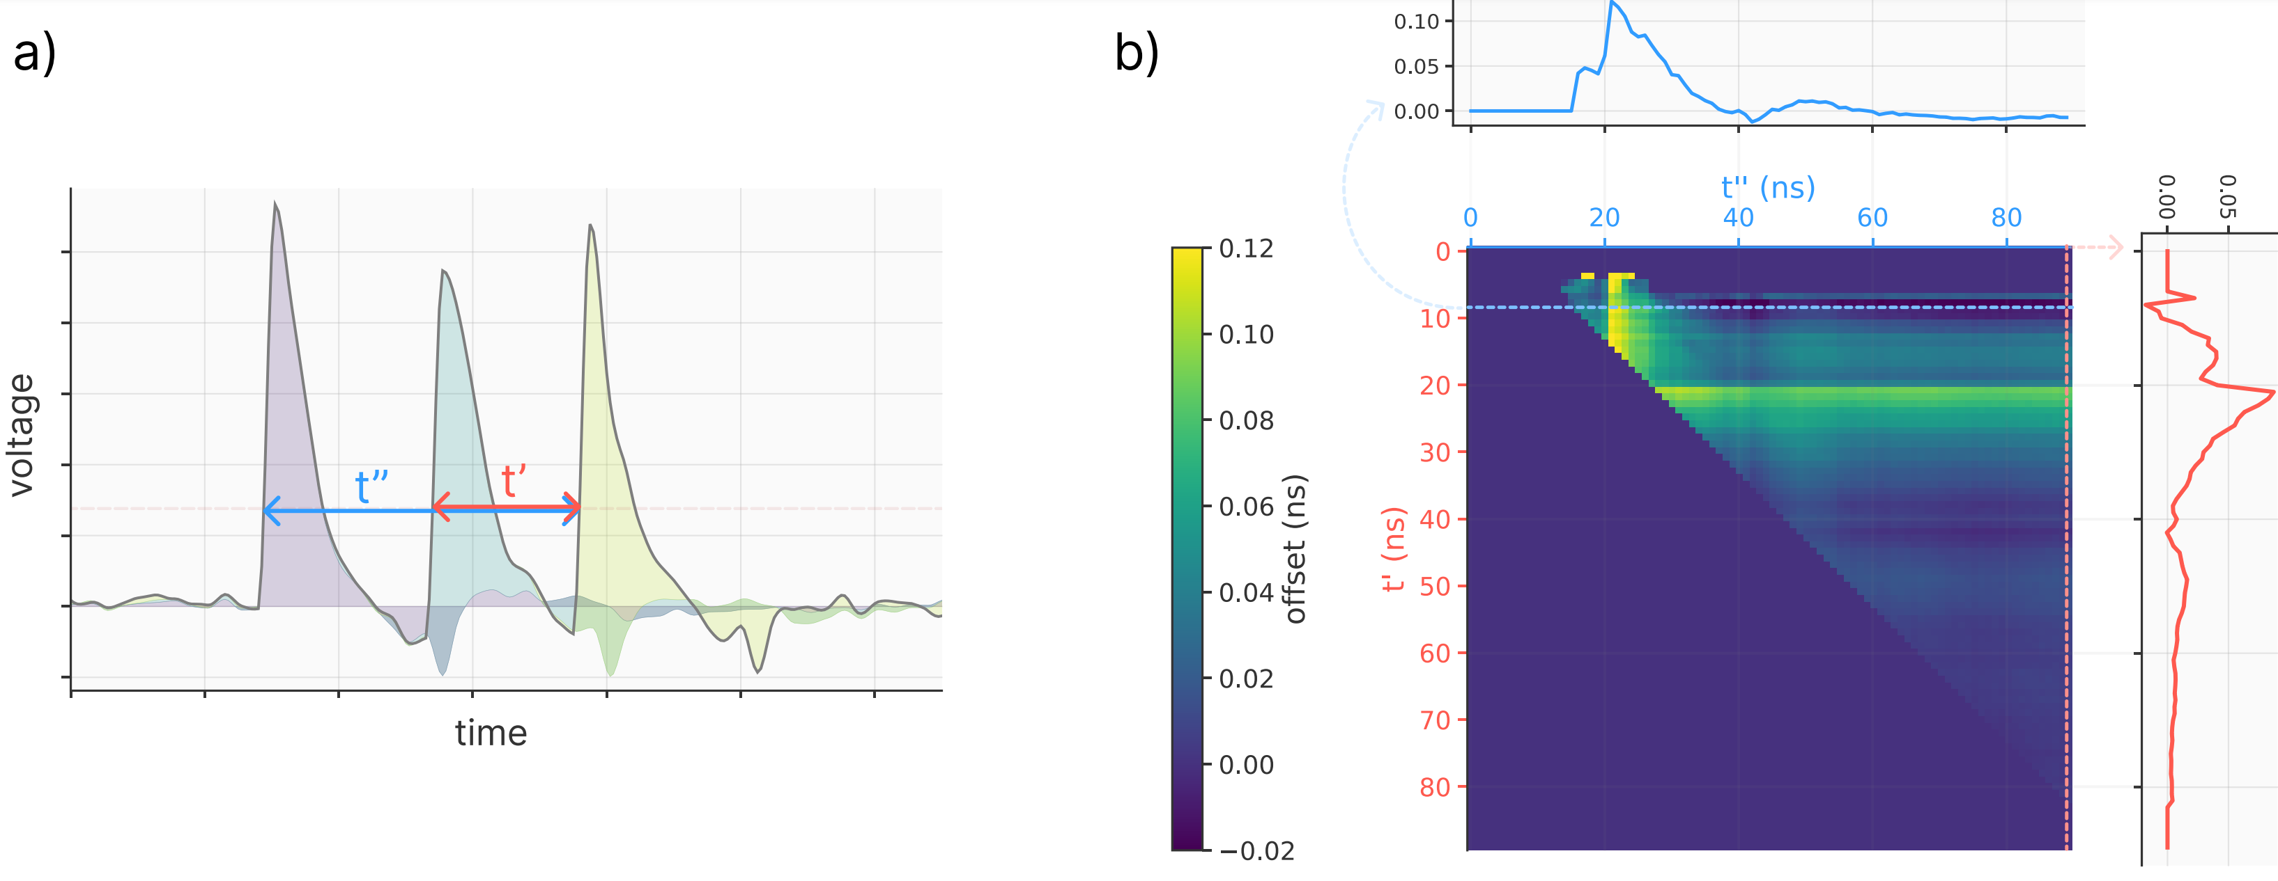
Time Walk Correction 8
voltage
time (ns)
Notes:
Notes for slide 1

Slide 15
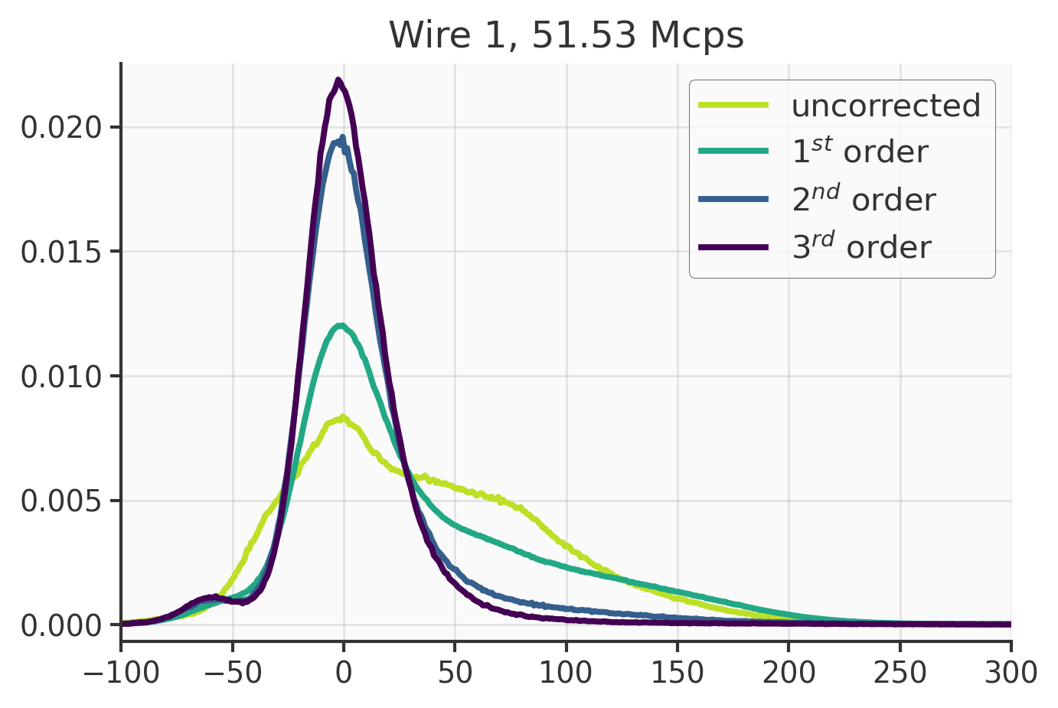
Time Walk Correction 8
voltage
time (ns)
Notes:
Notes for slide 1

Slide 16
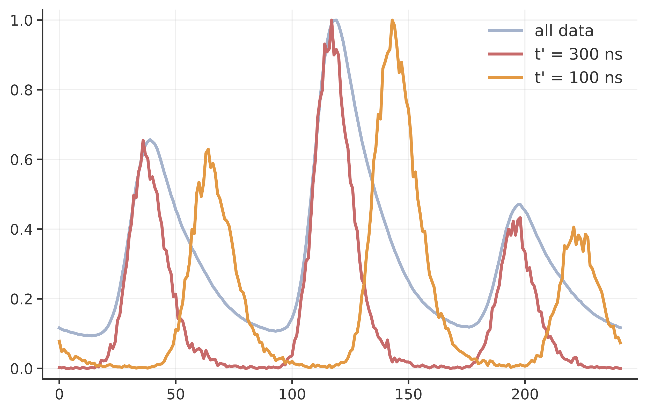
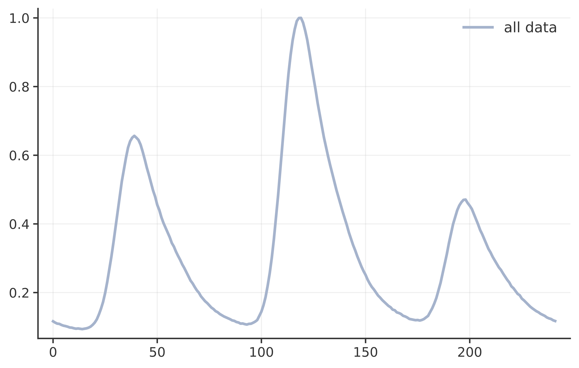
Time Walk Correction 9
Notes:
Notes for slide 1

Slide 17
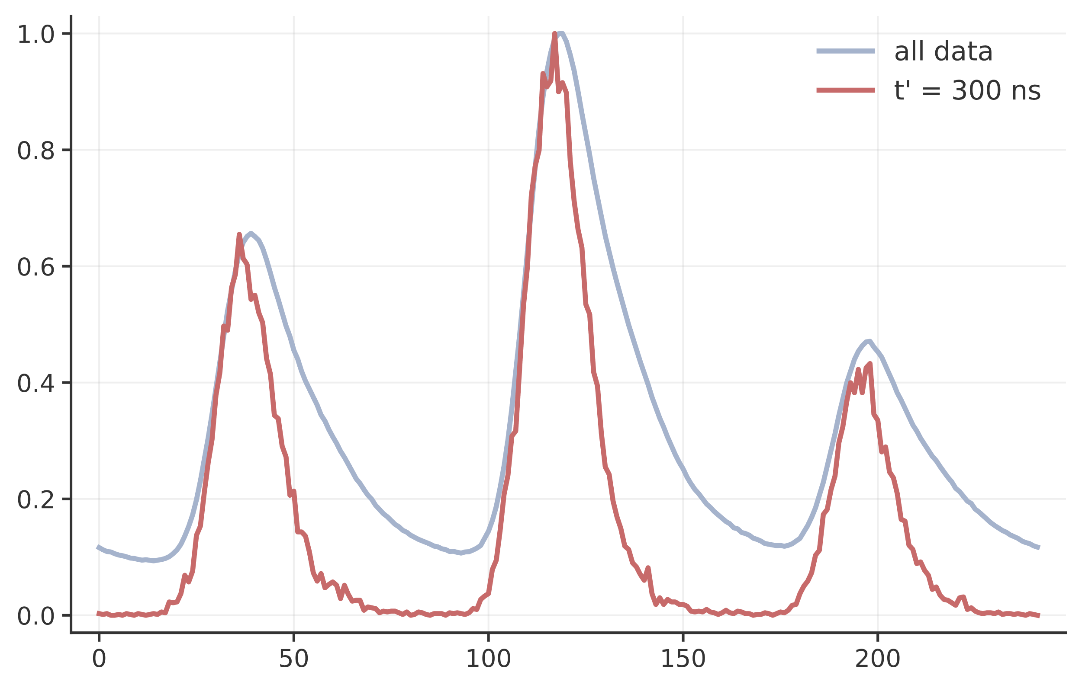
Time Walk Correction 9
Notes:
Notes for slide 1

Slide 18
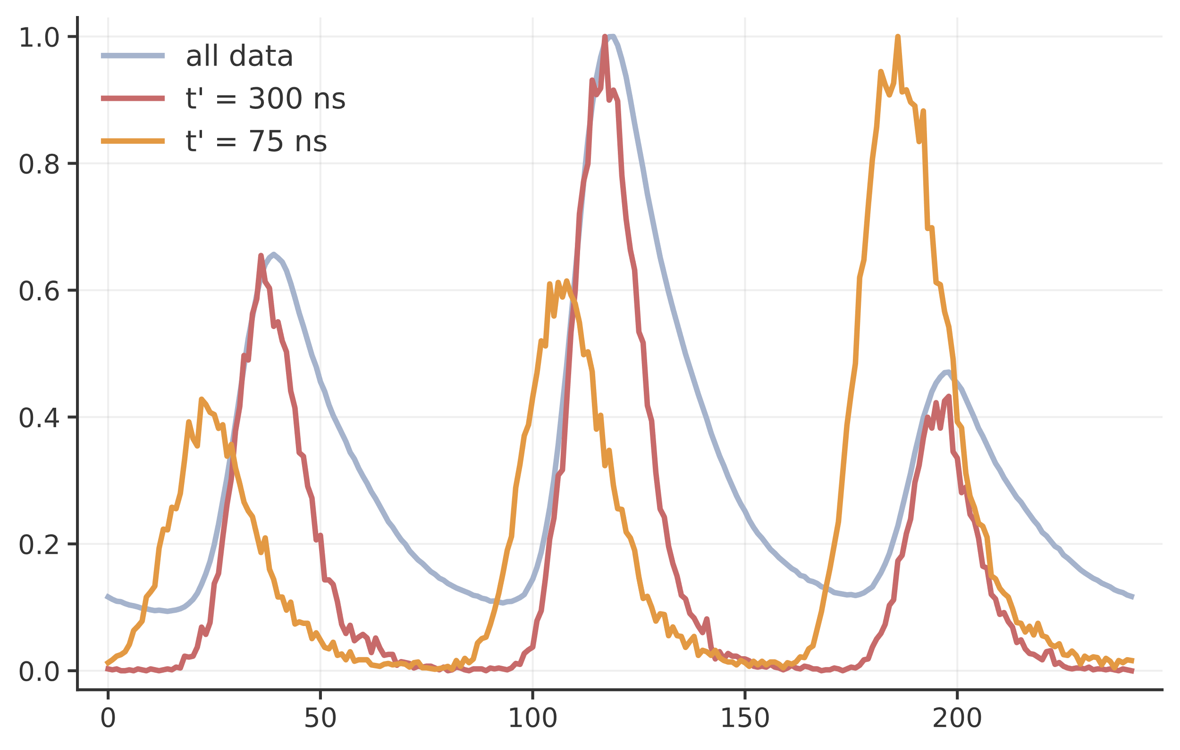
Time Walk Correction 9
Does the t’=75 ns data have a positive delay, or a negative delay?
Notes:
Notes for slide 1

Slide 19
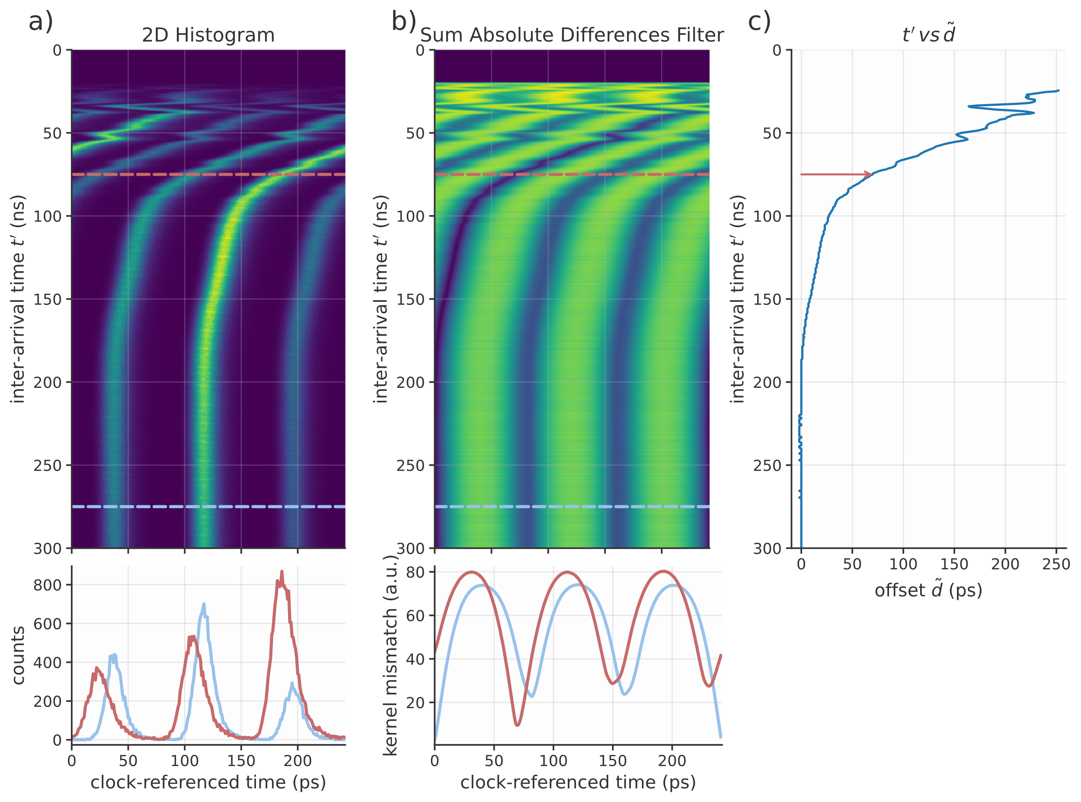
Time Walk Correction 10
Notes:
Notes for slide 1

Slide 20
Time Walk Correction 10
Notes:
Notes for slide 1

Slide 21
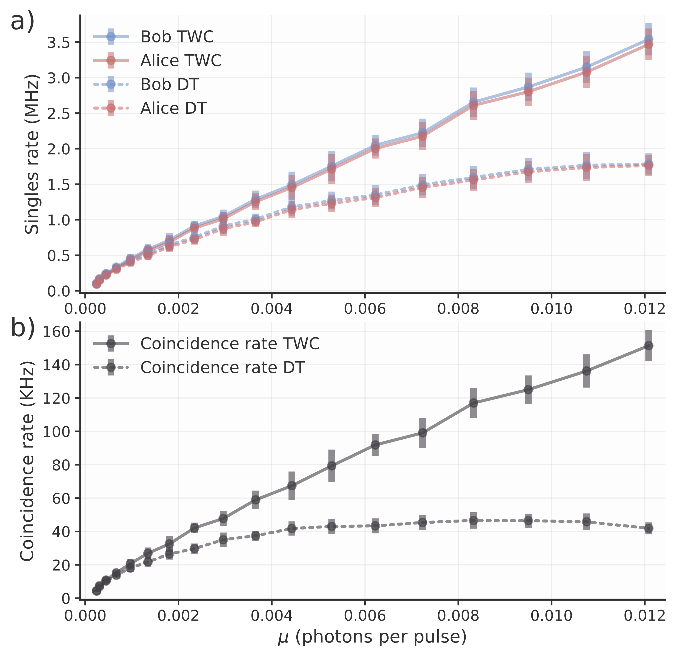
Time Walk Correction 11
Notes:
Notes for slide 1

Slide 22
Topics
Measurements Inside An Event Loop
Notes:
Notes for slide 1

Slide 23
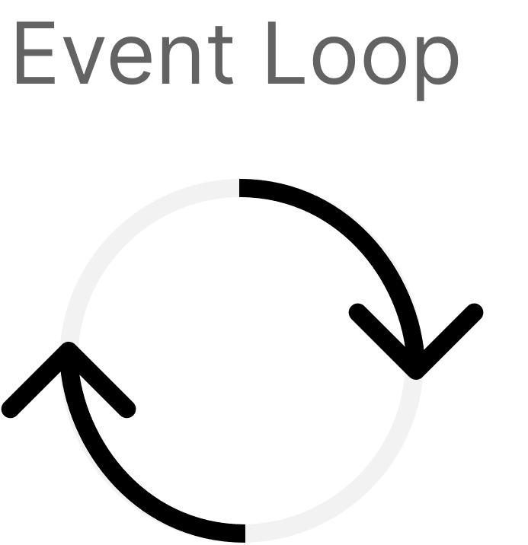
Measurements Inside An Event Loop
Load data
Process data
while 1:
timetags: np.array = timetagger.customMeasurement.getData()
process_tags(timetags)
Notes:
Notes for slide 1

Slide 24
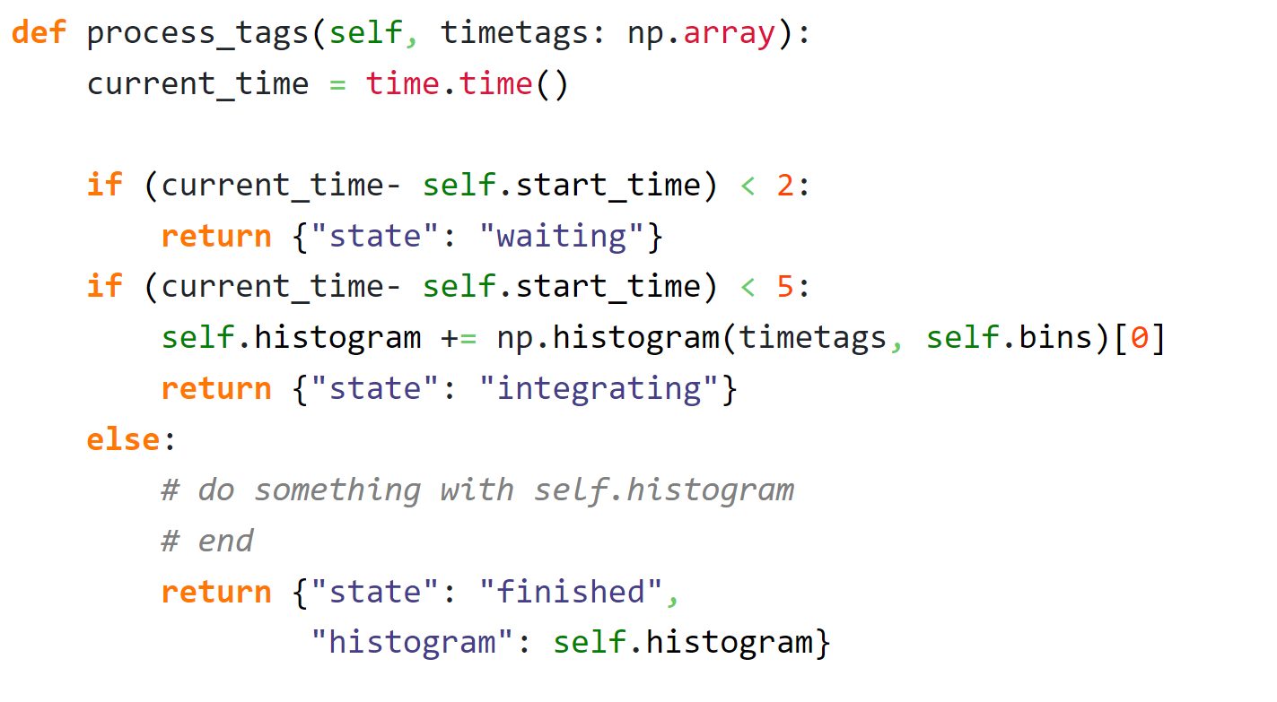
Measurements Inside An Event Loop
Notes:
Notes for slide 1

Slide 25
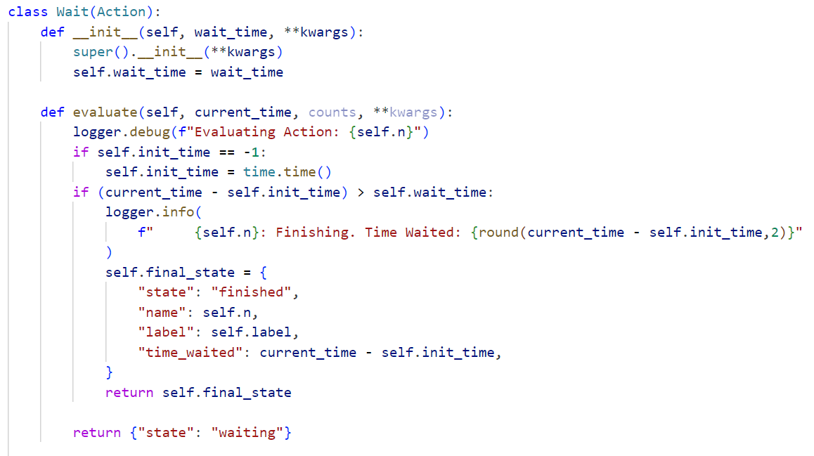
Measurements Inside An Event Loop
Notes:
Notes for slide 1

Slide 26
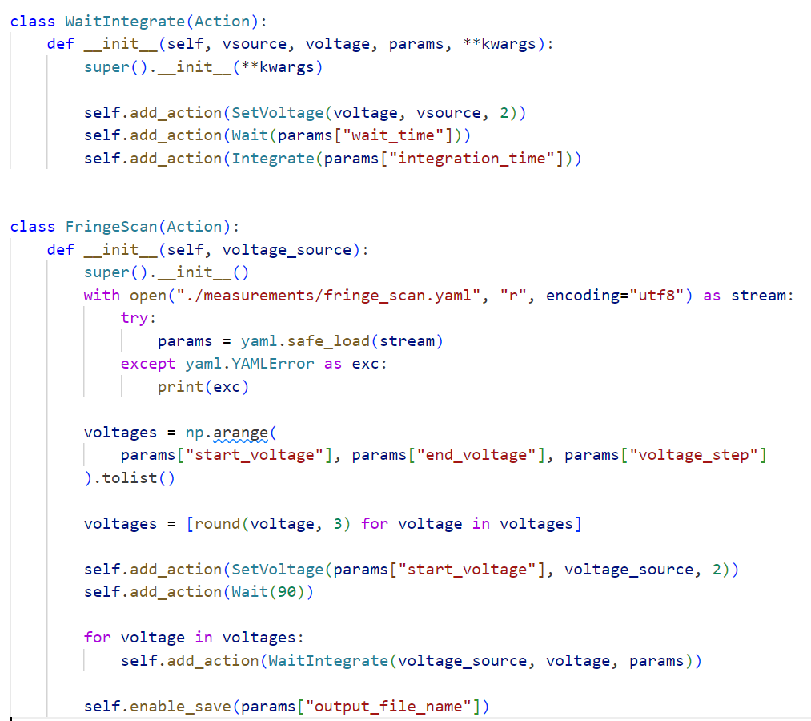
Measurements Inside An Event Loop
Notes:
Notes for slide 1

